Slide 1
CSE 465 Lecture 9
More CNN Architectures

Slide 2
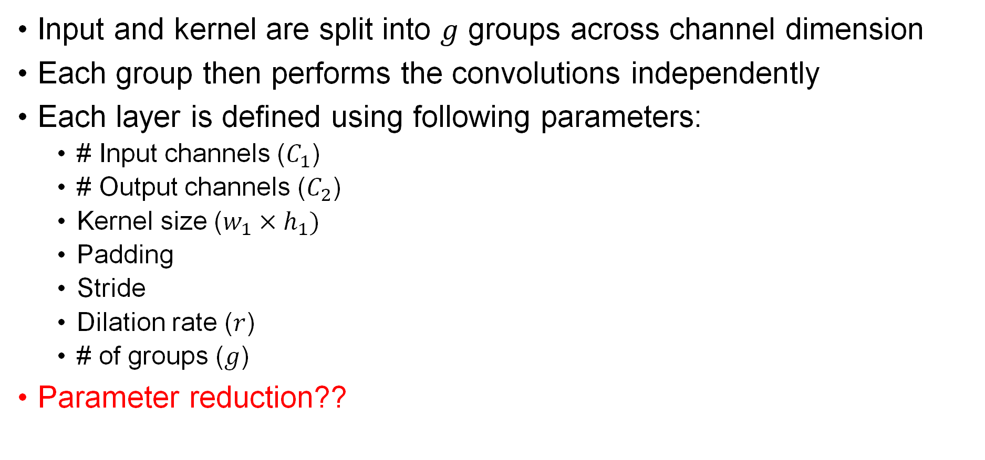
Group Convolution
Input and kernel are split into $g$ groups across channel dimension
Each group then performs the convolutions independently
Each layer is defined using following parameters:
# Input channels ($C_{1}$)
# Output channels ($C_{2}$)
Kernel size ($w_{1}×h_{1})$
Padding
Stride
Dilation rate ($r$)
# of groups ($g$)
Parameter reduction??

Slide 3
Group vs Standard Convolution Layer
Figure: Standard convolution
Figure: Grouped convolution

Slide 4
Depth-wise Convolution
Special case of group convolution where each channel is processed independently
# input channels = # groups = # output channels
Parameter reduction??

Slide 5
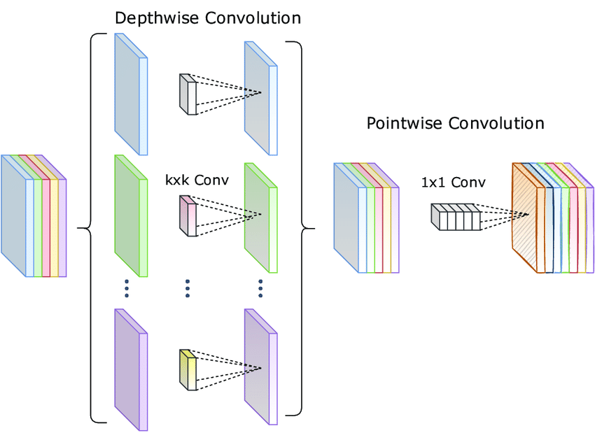
MobileNet
Replaces expensive convolution layers by a cheaper depthwise separable convolution, a 3×3 depthwise convolution layer followed by a 1×1 pointwise convolution layer
This requires a lot fewer learned parameters than a regular convolution but approximately does the same thing

Slide 6
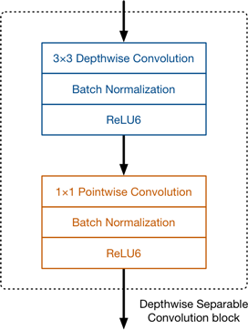
MobileNet
There are no pooling layers in between these depthwise separable blocks
Some of the depthwise layers have a stride of 2 to reduce the spatial dimensions of the data
In that case, the corresponding pointwise layer also doubles the number of output channels. If the input image is 224×224×3 then the output of the network is a 7×7×1024 feature map.

Slide 7
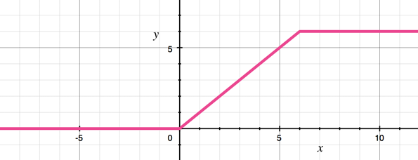
MobileNet
The convolution layers are followed by batch normalization.
The activation function used by MobileNet is ReLU6.
This is like the well-known ReLU but it prevents activations from becoming too big:

Slide 8
MobileNet
MobileNet can be configured using hyperparameters
The most important hyperparameter is the depth multiplier
That is how many channels are in each layer
Using a depth multiplier of 0.5 will halve the number of channels used in each layer
Reducing the number of computations roughly by a factor of 2
MobileNet is roughly nine times faster if used with depthwise separable convolution

Slide 10
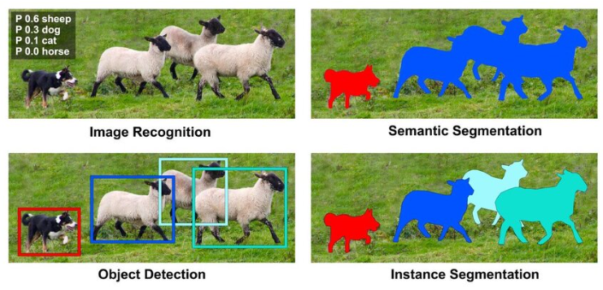
Image Processing

Slide 11
Neural Image Processing
Image recognition (classification): Assigns one or more labels to the entire image to say what is present.
Object detection: Finds and labels each object in the image with a bounding box to say what and roughly where.
Semantic segmentation: Classifies every pixel into a class, giving a dense map of what type of thing each pixel belongs to.
Instance segmentation: Identifies each object separately and gives a precise pixel-level mask for every individual instance.

Slide 12
UNET – CNN for semantic segmentation
UNET is one of the most popular architecture for medical image segmentation
It is designed to learn from few training samples
It uses fully convolutional scheme – no fully connected neurons are used
UNET is a U-shaped encoder-decoder network architecture
It consists of four encoder blocks and four decoder blocks that are connected via a bridge

Slide 13
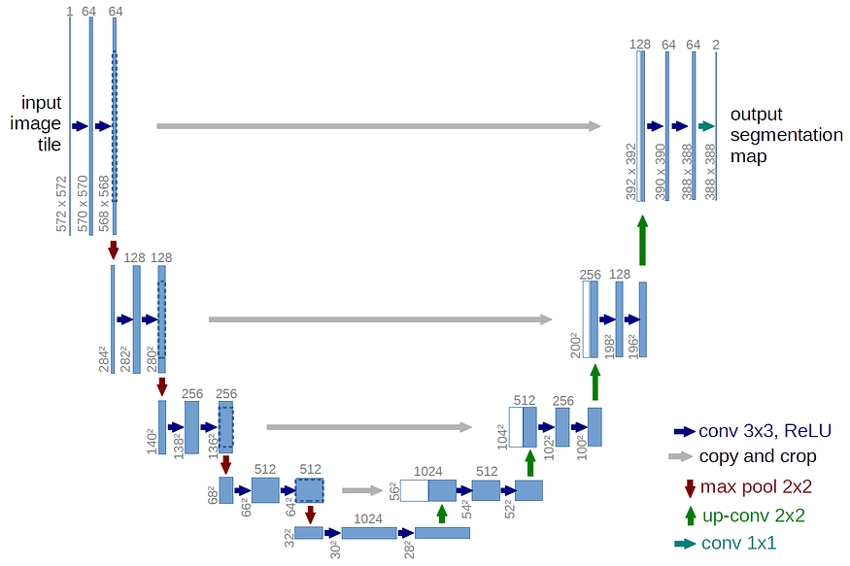
UNET – CNN for semantic segmentation

Slide 14
UNET – CNN for semantic segmentation
The encoder network (contracting path) half the spatial dimensions and double the number of features (feature channels) at each encoder block
The decoder network doubles the spatial dimensions and half the number of feature channels.

Slide 15
UNET – Encoder Block
The encoder network acts as the feature extractor and learns an abstract representation of the input image through a sequence of the encoder blocks
Each encoder block consists of two 3x3 convolutions followed by a ReLU (Rectified Linear Unit) activation function
Next follows a 2x2 max-pooling, where the spatial dimensions (height and width) of the feature maps are reduced by half
This reduces the computational cost by decreasing the number of trainable parameters

Slide 16
UNET – Skip Connection
Skip connections provide additional information that helps the decoder to generate better semantic features
They also act as a shortcut connection that helps the indirect flow of gradients to the earlier layers without any degradation
Skip connection helps better flow of gradient during backpropagation, which helps the network to learn better representation

Slide 17
UNET – bridge
The bridge connects the encoder and the decoder network and completes the flow of information
It consists of two 3x3 convolutions, where a ReLU activation function follows each convolution

Slide 18
UNET – Decoder
The decoder network is used to take the abstract representation and generate a semantic segmentation mask
The decoder block starts with a 2x2 transpose convolution
Next, it is concatenated with the corresponding skip connection feature map from the encoder block
After that, two 3x3 convolutions are used, where a ReLU activation function follows each convolution

Slide 19
Transpose Convolution
A transposed convolution (can be thought as) the reverse of convolution
Get back to the same spatial resolution as the original image
A transposed convolutional layer carries out a regular convolution but reverts its spatial transformation

Slide 20
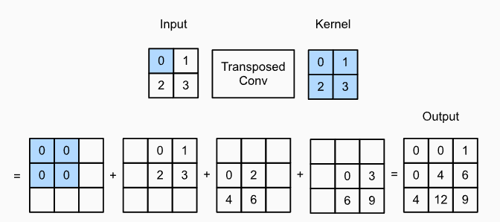
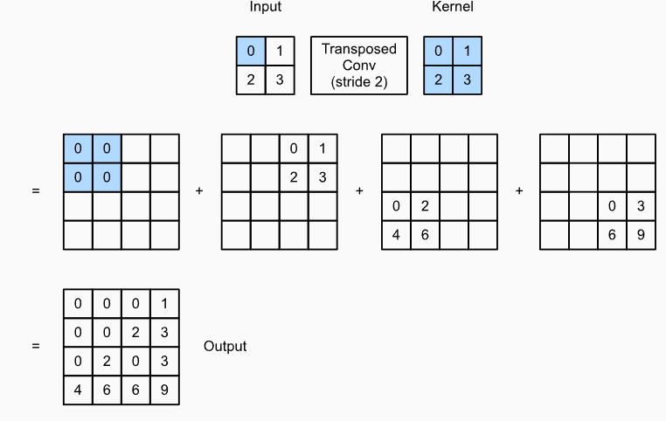
Transpose Convolution

Slide 21
Dilated Convolution

Slide 22
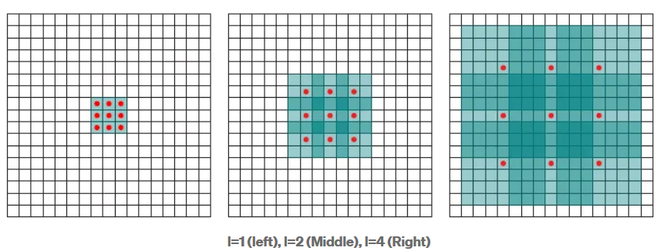
Dilated Convolution

